Slide 1
Kubernetes on Azure

Slide 2
Agenda
Introduction to Containers
Kubernetes Momentum
Azure services for containers
AKS Labs / Demo

Slide 3
What is a container?
Containers
Containers
VM
VM
App1
App2
App1
App1
Binaries & libraries
Binaries & libraries
Binaries & libraries
Binaries & libraries
Guest OS
Guest OS
Virtual machines
Containers
Virtualize the hardware
Virtualize the operating system
VMs as units of scaling
Applications as units of scaling

Slide 4
Traditional virtualized environment
From dev to production agility across development and operations teams
Virtual machine
Virtual machine
Low utilization of resources
Containerization of applications and their dependencies for portability
Container
Container
Container
Container
App
App
Hypervisor
Host OS
Hardware

Slide 5
Advantages of a containerized environment
Containers are lighter weight and faster to scale dynamically
Migrate containers and their dependencies to underutilized VMs for improved density and isolation
Virtual machine
Virtual machine
Container
Container
Decommission unused resources for efficiency gains and cost savings
Container
Container
App
Hypervisor
Docker Engine
Host OS
Hardware

Slide 6
The benefits of using containers
Agility
+
Ship apps faster
Portability
+
Easily move workloads
Density
+
Achieve resource efficiency
Rapid scale
+
Scale easily to meet demand

Slide 7
The elements of orchestration
Scheduling
Affinity/anti-affinity
Health monitoring
Failover
Scaling
Networking
Service discovery
Coordinated app upgrades

Slide 8
Kubernetes momentum

Slide 9
By 2022
75
>
%
of global organizations will be running containerized applications in production¹
¹Gartner.
Notes:
Full statistic sources
Gartner. “6 Best Practices for Creating a Container Platform Strategy.” April 23, 2019. https://www.gartner.com/smarterwithgartner/6-best-practices-for-creating-a-container-platform-strategy/

Slide 10
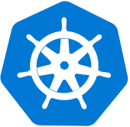

Kubernetes on its own is not enough
Save time from infrastructure management and roll out updates faster without compromising security
Development
Platform
Unlock the agility for containerized applications using:
Infrastructure automation that simplifies provisioning, patching, and upgrading
Tools for containerized app development and CI/CD workflows
Services that support security, governance, and identity and access management
IDE container support
Security
Governance
Identity
Source code repository
Kubernetes
Registry supporting
Helm
CI/CD
Infrastructure automation
Monitoring
Virtual machines
Networking
Microservice debugging
Storage
Data

Slide 11

Kubernetes on Azure Enterprise-grade by design
Built-in best practices
Multi-layer security
Operational efficiency
Unified management
Proactive and actionable recommendations, and support from experts, based on knowledge from thousands of enterprise engagements
Hardened security and layers of isolation across compute resources, data, and networking
Automated provisioning, repair, monitoring, and scaling gets you up and running quickly and minimizes infrastructure maintenance
Consistent configuration and governance across on premises, multi clouds and edge

Slide 12






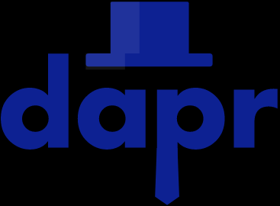


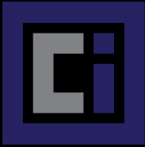



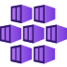
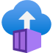
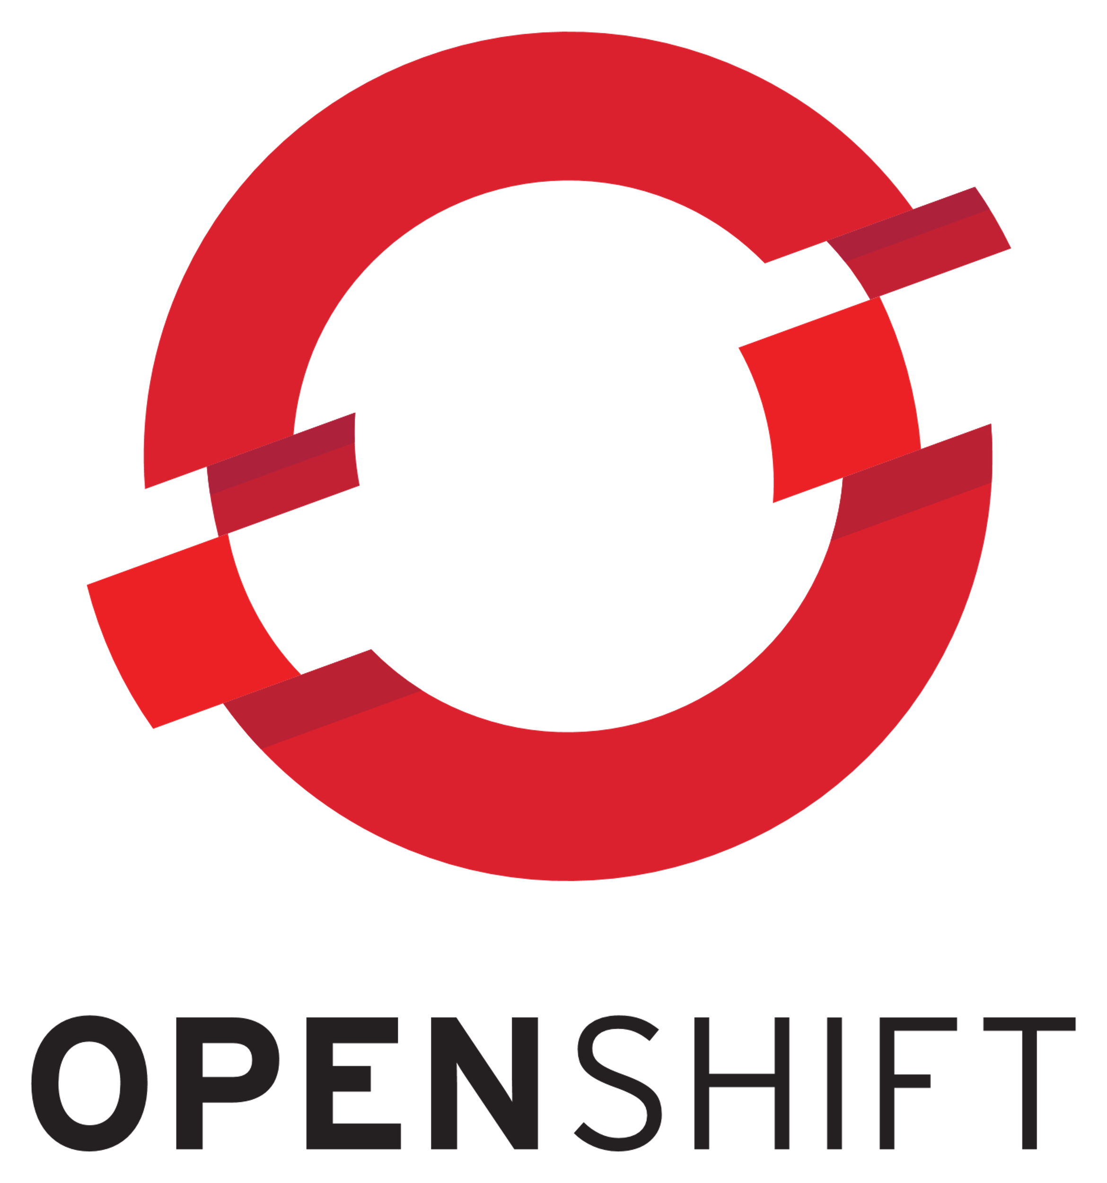


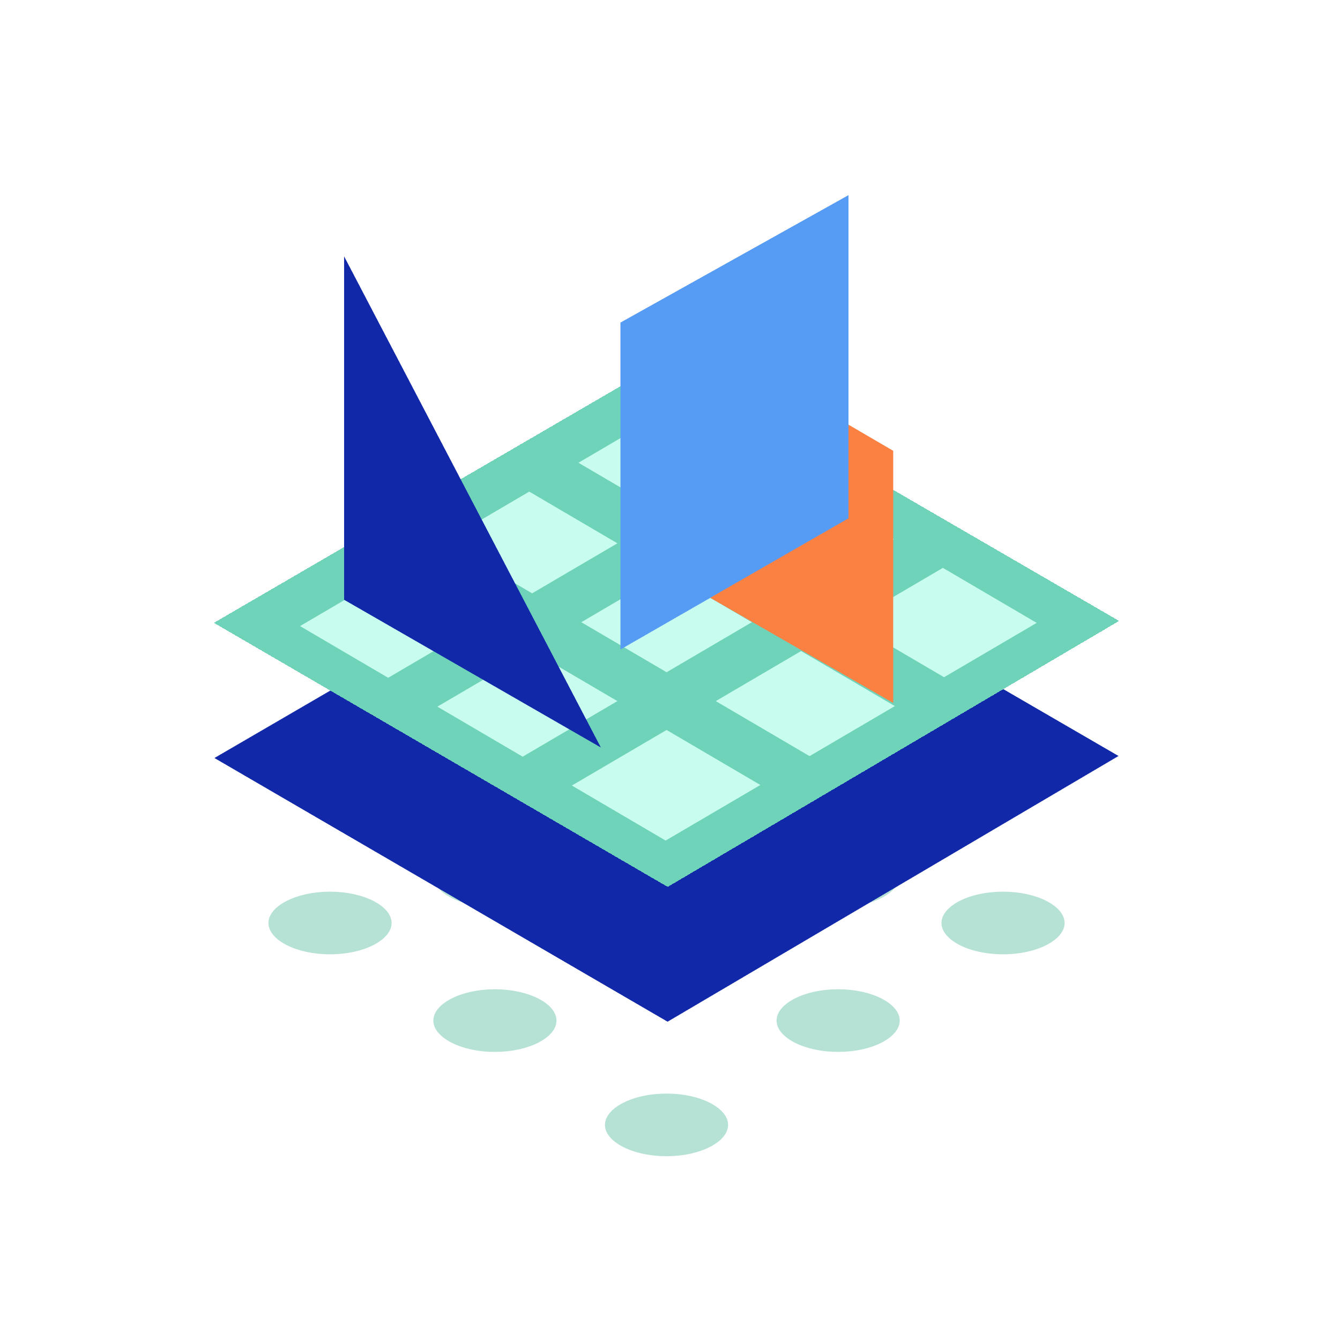



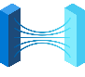
Kubernetes on Azure | Enterprise-grade by design
Development Tools
Platform
Community
Visual Studio Code
Dapr
CNAB
Active Directory
Azure Policy
Security Center
Key Vault
Azure Advisor
Helm
Open Container Initiative
GitHub
Virtual Kubelet
Gatekeeper
Azure Container Registry
KEDA
Open Service Mesh
Azure Kubernetes Service
Azure Container Instances
Azure Red Hat OpenShift
Azure Monitor
Draft
VS Code Kubernetes Extensions
Azure Arc Management across environments

Slide 13






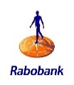





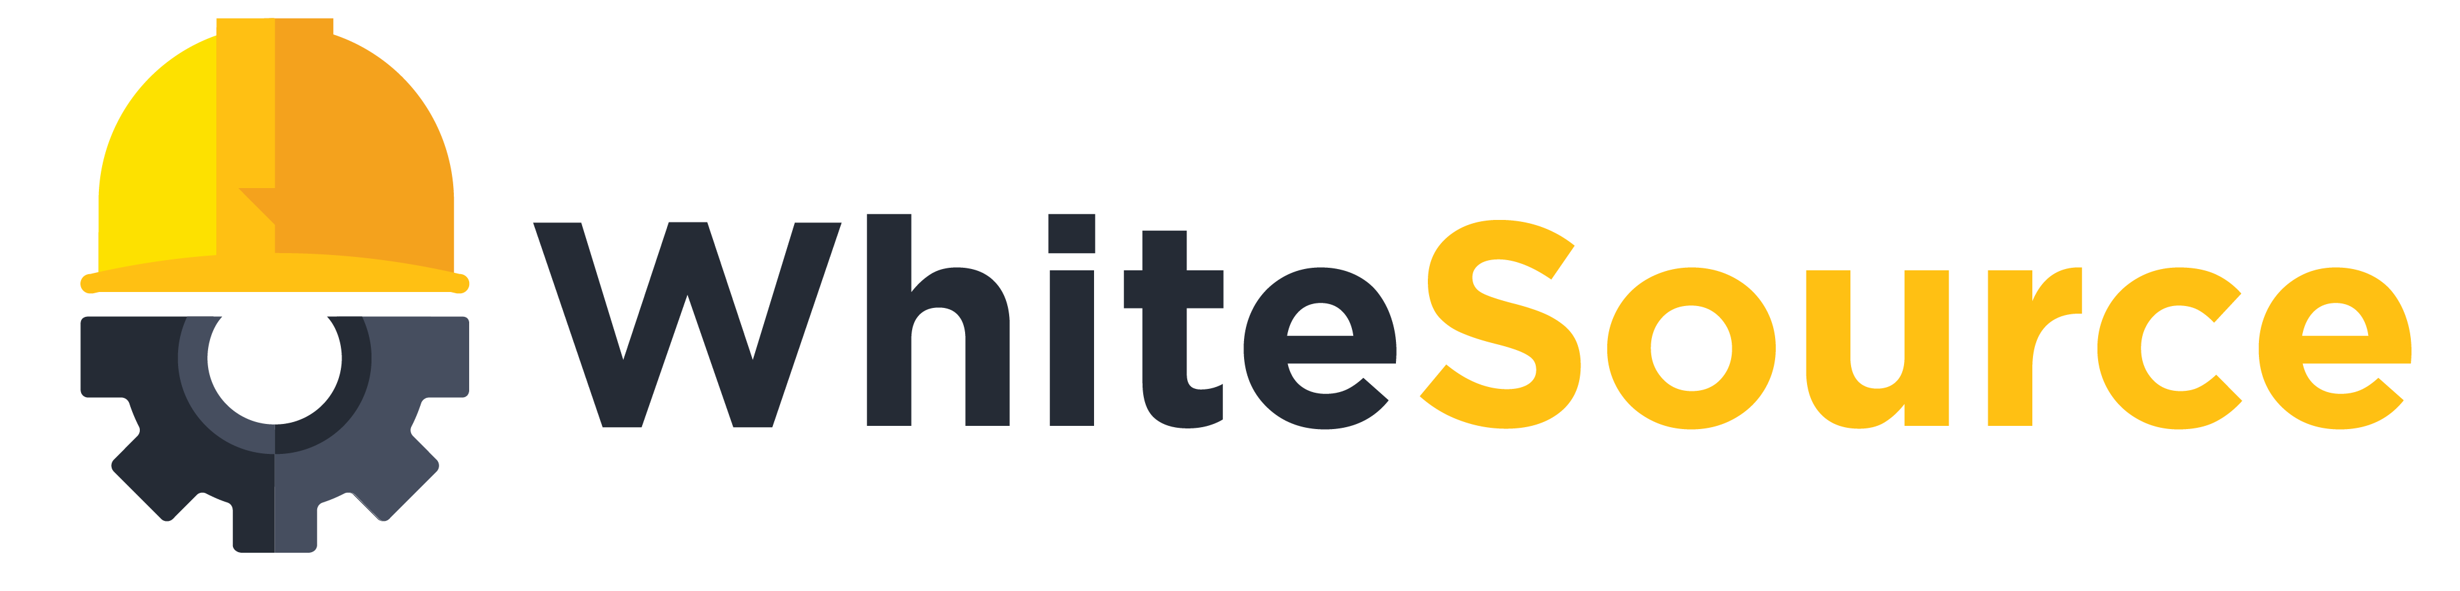












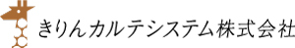



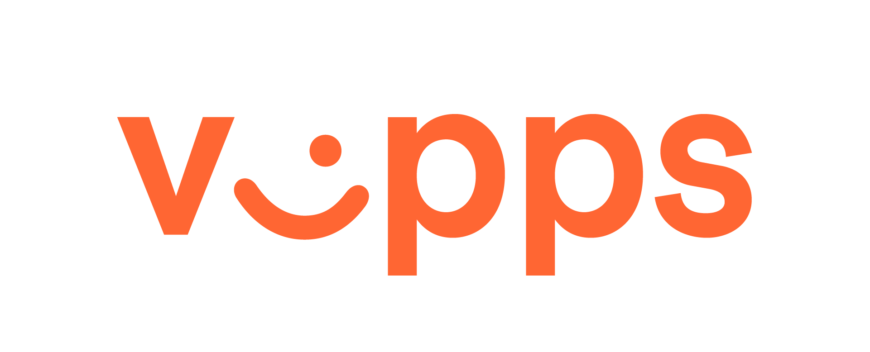




Azure Kubernetes Service momentum
Trusted by thousands of customers
The fastest growing compute service on Azure

Slide 14
Top scenarios

Slide 15
Top scenarios for Kubernetes on Azure
Lift and shift to containers
Secure DevOps
Microservices
Cost saving
without refactoring your app
Agility
Faster application development
Automation
Deliver code faster and securely at scale
Machine learning
IoT
Data streaming
Performance
Low latency processing
Portability
Build once, run anywhere
Analytics
Real-time data collection and streaming

Slide 16
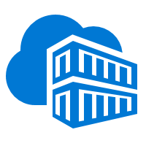
App modernization without code changes
Lift and shift to containers
Microservices
Secure DevOps
Machine learning
IoT
Data streaming
Speed application deployments by using container technology
Defend against infrastructure failures with container orchestration
Increase agility with continuous integration and continuous delivery
Kubernetes cluster
Existing application
Container Registry
CI/CD
Modernized application
Modernized application
Modernized application
Managed Database

Slide 17
Microservices: for faster app development
Lift and shift to containers
Microservices
Secure DevOps
Machine learning
IoT
Data streaming
Monolithic
Microservices
Large, all-inclusive app
Small, independent services
Independent deployments
Improved scale and resource utilization per service
Smaller, focused teams
App
App
App

Slide 18




Microservices for faster app development
Lift and shift to containers
Microservices
Secure DevOps
Machine learning
IoT
Data streaming
Capabilities
4
Inner loop
Azure Container Registry
AKS production cluster
Source code control
Pods
Azure Monitor
Use Visual Studio Code to iteratively develop, test, and debug microservices targeted for AKS clusters.
͏Azure Pipelines has native integration with Helm and helps simplifying continuous integration/continuous delivery (CI/CD)
͏Virtual node—a Virtual Kubelet implementation—allows fast scaling of services for unpredictable traffic.
͏Azure Monitor provides a single pane of glass for monitoring over app telemetry, cluster-to-container level health analytics.
Visual Studio Code
AKS dev cluster
Test
Debug
1
Auto-build
2
3
Container instances
Pods
CI/CD Pipelines
https://github.com/Microsoft/SmartHotel360-AKS-DevSpaces-Demo

Slide 19

Secure DevOps
Lift and shift to containers
Microservices
Secure DevOps
Machine learning
IoT
Data streaming
Deliver code faster with Kubernetes and CI/CD
Accelerate the feedback loop with constant monitoring
Balance speed and security with continuous security and deep traceability
Source code
Build
Pipelines
Release Pipelines
Kubernetes cluster
Continuous Integration
Continuous Delivery
Deployment strategies
Monitor & logging
Iterate
Monitor

Slide 20
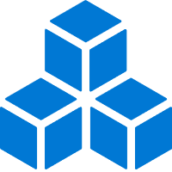
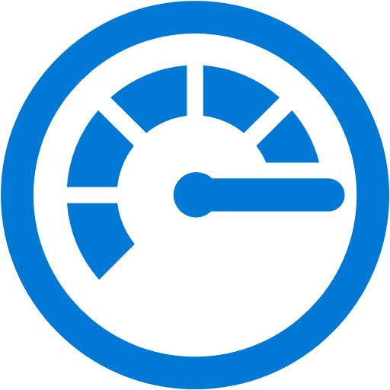

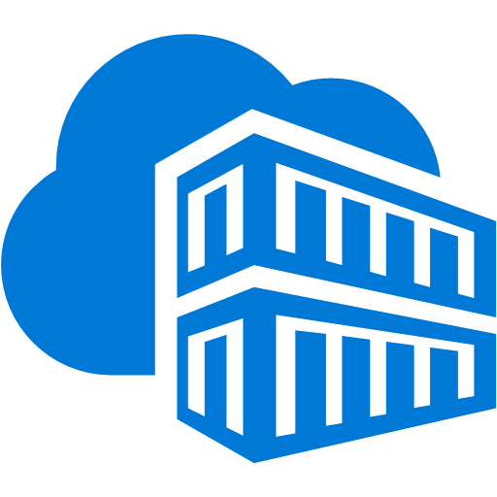
Data scientist in a box
Lift and shift to containers
Microservices
Secure DevOps
Machine learning
IoT
Data streaming
Data scientist
Capabilities
Create/ retain model
Data Scientist creates the model
Register Model using the Model Registry
Register Image using the Image Registry (the Azure Container Registry)
Deploy the Image to cloud or to edge devices using AKS
Monitor and use models—you can monitor input, output, and other relevant data from your model. Developers can query the model for insights for apps
App Developer
Monitor
1
Register model
5
2
Heavy Edge
Light Edge
Create scoring files and dependencies
Cloud
Create and register image
w/ ACR
Deploy image w/ AKS
4
3

Slide 21
Scalable Internet of Things solutions
Lift and shift to containers
Microservices
Secure DevOps
Machine learning
IoT
Data streaming
Decrypt
Decompress
Send to Storage
Compress
Encrypt
Send to Cloud
Capabilities
1
͏Azure IoT Edge encrypts data and send to Azure, which then decrypts the data and send to storage
Azure
Azure IoT Edge
Kubernetes cluster
͏Kubelets serve as the translator between cloud and Edge
2
3
4
Node
Node
kubelet
kubelet
Docker container
Docker container
Docker container
Docker container
Docker container
IoT Edge Provider
Docker containers
͏IoT Edge Provider in kubelet redirects containers to IoT Edge and extend AKS cluster to target millions of edge devices
Consistent update, manage, and monitoring as one unit in AKS using single pod definition

Slide 22

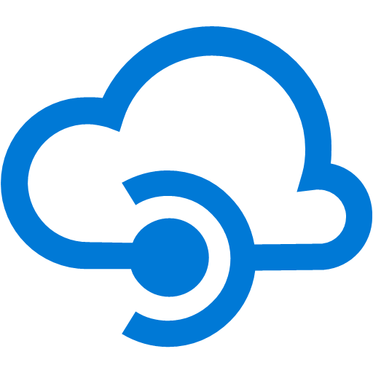


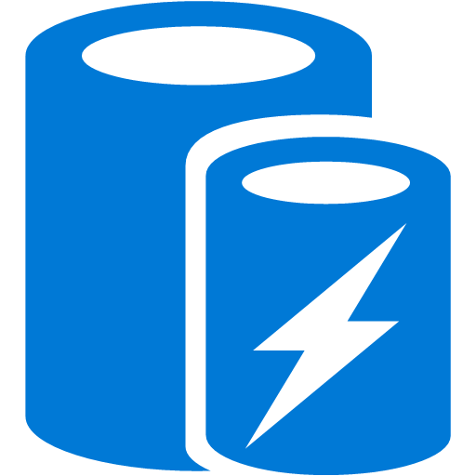
Data streaming
Lift and shift to containers
Microservices
Secure DevOps
Machine learning
IoT
Data streaming
Azure Cosmos DB
AKS
API Management
Real-time data gathered and streamed to AKS
Collected data analyzed and insights generated almost instantly
Data stored and available for deeper analysis by data scientists
IoT sensor
Storage
Apache Kafka
HDInsight
Analysis
Database for PostgreSQL
Cache for Redis

Slide 23


Kubernetes is built and maintained by the community
148,000 commits
35,000 contributors
#1 GitHub project
Kubernetes collects wisdom, code, and efforts from hundreds of corporate contributors and thousands of individual contributors
Microsoft is part of this vibrant community and leads in the associated committees to help shape the future of Kubernetes and its ecosystem
CNCF platinum member
CNCF technical oversight committee
CNCF governing board
Kubernetes steering committee
Linux Foundation board member
AKS is certified Kubernetes conformant, ensuring portability and interoperability of your container workloads

Slide 24




Microsoft contributions to the community
Packaging & distribution
Dapr
CNAB
Helm
Open Container Initiative
Virtual Kubelet
Gatekeeper
Scalability & control
KEDA
Open Service Mesh
Kubernetes developer tooling
Draft
VS Code Kubernetes Extensions

Slide 25
Resources

Slide 26






Best support for your enterprise need
Learning path aka.ms/LearnKubernetes
What is Kubernetes aka.ms/k8sLearning
Hear from experts aka.ms/AKS/videos
Case studies aka.ms/aks/casestudy
See what’s new aka.ms/k8s/roadmap
Try for free aka.ms/aks/trial
Feedback on the roadmap? Tell us at https://aka.ms/aks/feedback

Slide 27
Backup

Slide 28
Increase operational efficiency
Focus on your containers and code, not the plumbing of them
Responsibilities | DIY with Kubernetes | Managed Kubernetes on Azure
Containerization
Application iteration, debugging
CI/CD
Provisioning, upgrades, patches
Reliability availability
Scaling
Monitoring and logging
Azure managed control plane
App/ workload definition
Self-managed master node(s)
Kubernetes API endpoint
etcd Store
User
API server
Scheduler
Controller Manager
Cloud Controller
Schedule pods over private tunnel
Customer VMs
Docker
Docker
Docker
Docker
Docker
Pods
Pods
Pods
Pods
Pods
Customer
Microsoft
Notes:
A Kubernetes cluster is typically made up of
Master nodes for system components like the API server, etcd store, and scheduler
Agent nodes for user container workloads
Managing the cluster involves:
Monitoring the API server
Ensuring HA/DR for the etcd store
Safely managing upgrades across Kubernetes versions
Safely scaling the cluster in and out
Patching master and agent VM nodes
And on and on…
This is complex, error-prone, and expensive
A managed service like AKS moves those tasks to the cloud provider

Slide 29
Serverless Kubernetes using AKS virtual nodes
Elastically provision compute capacity in seconds
No infrastructure to manage
Built on open sourced Virtual Kubelet technology, donated to the Cloud Native Computing Foundation (CNCF)
Node
Node
Pods
Pods
Azure Container Instances (ACI)
Kubernetes control plane
Pods
Virtual node
Notes:
More information: https://azure.microsoft.com/en-us/blog/bringing-serverless-to-azure-kubernetes-service/
Virtual nodes feature is currently only available for Linux.

Slide 30
Horizontal Pod Autoscaler
The horizontal pod autoscaler (HPA) uses the Metrics Server in a Kubernetes cluster to monitor the resource demand of pods. If a service needs more resources, the number of pods is automatically increased to meet the demand.
͏HPA obtains resource metrics and compares them to user-specified threshold
2
Node1
Horizontal Pod Autoscaler
Pod
3
Deployment
ReplicaSet
͏HPA evaluates whether user specified threshold is met or not
replicas++
Kubelet
replicas--
4
cAdvisor
Pod
͏HPA increases/decreases the replicas based on the specified threshold
Grabs metrics
1
NodeX
͏The Deployment controller adjusts the deployment based on increase/decrease in replicas
Metrics Server
Node2
Pod
Collects metrics from all containers on the node
Kubelet
Collects metrics from all nodes
cAdvisor

Slide 31
Cluster Autoscaler
The cluster autoscaler watches for pods that can't be scheduled on nodes because of resource constraints. The cluster then automatically increases the number of nodes.
͏HPA obtains resource metrics and compares them to user-specified threshold
Cluster Autoscaler
Azure
Pod
Pod
2
1
͏HPA evaluates whether user specified threshold is met or not
Additional nodes needed
Pods are in pending state
͏HPA increases/decreases the replicas based on the specified threshold
3
Pending pods are scheduled
Node is granted
4
͏The Deployment controller adjusts the deployment based on increase/decrease in replicas
AKS cluster
Node
Node
Pod
Pod
Pod
Pod

Slide 32
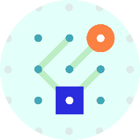

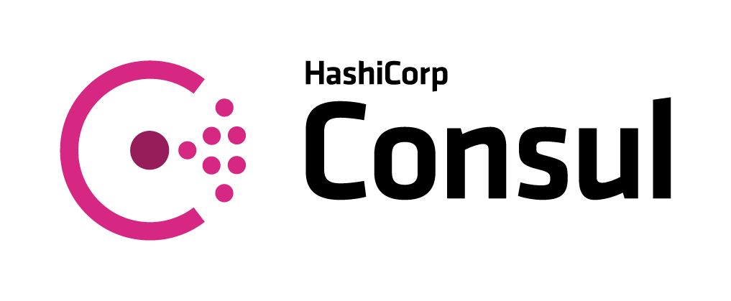

Service Mesh Interface (SMI)
Apps
Tooling
Ecosystem
SMI defines a set of APIs that can be implemented by individual mesh providers. Service meshes and tools can either integrate directly with SMI or an adapter can consume SMI and drive native mesh APIs.
​Standard interface for service mesh on Kubernetes​
​Basic feature set to address most common scenarios​
​Extensible to support new features as they become widely available​
Service Mesh Interface
Routing
Telemetry
Policy
…and more
Kubernetes

Slide 33
Build on an enterprise-grade, secure platform
Control access through AAD and RBAC
Get runtime vulnerability scanning and auditing through Azure Security Center
Put guardrails in your development process with Azure Policy
Secure network communications with VNET and network policy
Gain automated threat protection and best practice recommendations for Kubernetes clusters

Slide 34

Identity
Use familiar tools like AAD for fine-grained identity and access control to Kubernetes resources from cluster to containers
Storage
AKS with RBAC
Active Directory
VNet
Active Directory
SQL Database
Node
Node
Synced identity
Pod
Pod
AAD Pod Identity
Cosmos DB
Key Vault

Slide 35
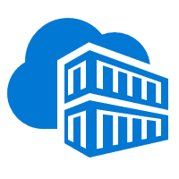

Image Security
Your private registry, with built-in Helm chart support, only deploys validated images and can be automatically geo-replicated to the data center close to where your users are
Developer
Azure Container Registry
Azure Kubernetes Service
CI/CD Pipelines
Image scanning
Fail
Pass
Admin
Vulnerability scanning
Actionable recommendations

Slide 36
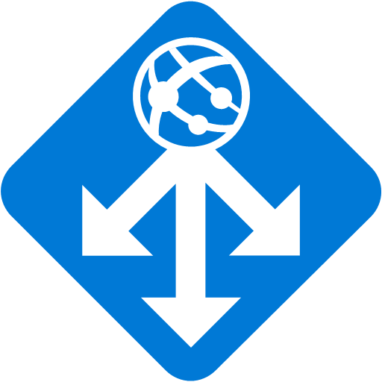
Networking
Secure your Kubernetes workloads with virtual network and policy-driven communication paths between resources
Kubernetes cluster: Azure VNET
Internal Load Balancer
Egress lockdown
External DNS
Control plane
Ingress Controller
App Gateway
Private cluster
Worker node
Worker node
kubelet
Pods
Pods
kubelet
Containers
Containers
Namespace

Slide 37

Governance
Dynamically enforce guardrails defined in Azure Policy across multiple clusters—nodes, pods, and even container images can be tracked and validated at the time of deployment or as part of CI/CD workflows
Cloud Architect
Azure Policy
Compliance reports
Assigns a policy across clusters
Cluster-1
Cluster-2
Cluster-3
Compliance reports for the entire environment, with pod-level granularity
Real-time enforcement of policy and feedback
AKS
Developer
Cluster-1
Cluster-2
Cluster-3

Slide 38
Azure Pipelines build audit & enforcement using Azure Policy
Cloud architect assigns a policy across clusters; policy can be set to block non-compliance (deny) or generate non-compliance warnings (audit)
Cloud Architect
Azure Policy
1
Developer makes code change that kicks off a build on Azure Pipelines
Azure Pipelines evaluates the request for policy compliance
CI/CD Pipelines
4
Yes
Deny policy
No
If policy is set to deny, Azure Pipelines rejects the build attempt if any non-compliance is identified
Developer
Fail
5
Compliance check
AKS
2
3
If policy is set to audit, a non-compliance event is logged and the build is allowed to proceed
Cluster-1
Cluster-2
Cluster-3
Pass

Slide 39
Azure Policy for clusters
Cloud architect assigns a deployment policy across cluster(s)
Cloud Architect
Azure Policy
Developer uses standard Kubernetes API to deploy to the cluster
1
Real-time deployment enforcement (acceptance/denial) provided to developer based on policy
Compliance reports
4
Cluster-1
Cluster-2
Cluster-3
Cloud architect obtains compliance report for the entire environment and can drill down to individual pod level
AKS
Developer
3
Cluster-1
Cluster-2
Cluster-3
2
Notes:
Azure policy for AKS allows users to select from a pre-defined set of policies and assign them to AKS clusters. They can check if resources that are currently deployed to AKS are in compliance with the assigned policies and take the appropriate action to rectify. If users try to create resources that are not compliant they will be denied and presented a message with policy that causing the denial.
Gatekeeper (OSS)
Gatekeeper is a generic policy controller for Kubernetes. It’s backed by open policy agent and allows users to write policy to ensure Kubernetes resources are compliant. Gatekeeper was initial written by MSFT upstream engineers and donated to the open policy agent organization under CNCF. Since then, we have been collaborating with other companies for example Google, Capital One, Commonwealth Bank of Australia, Styra on producing a stable release of the code.

Slide 40
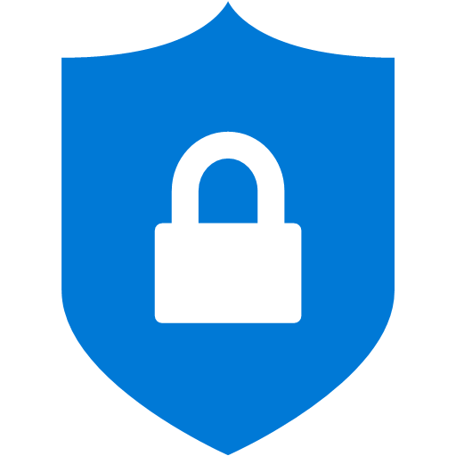
Threat protection Automated threat detection and best practices recommendation for Kubernetes clusters using advanced analytics from Azure Security Center
Azure Security Center
Continuous discovery of managed AKS instances
Actionable recommendations for security best practices
Detect threats across AKS nodes and clusters using advanced analytics
Azure Kubernetes Service
Cluster
Cluster
Cluster

Slide 41

AKS Support in Azure Security Center
1
For managed subscriptions, each new AKS cluster and node are discovered in ASC
Azure Security Center
Continuous discovery of managed AKS instances
Raw security events
ASC monitors AKS cluster for security misconfigurations and provides actionable recommendations for compliance with security best practices
2
Actionable recommendations for security best practices
Audit log
a
Detect threats across AKS nodes and clusters using advanced analytics
ASC continuously analyzes AKS for potential threats based on:
Azure Kubernetes Service
b
Raw security events such as network data and process creation
AKS security configuration
Verified by Security Center
Node1
Node2
Node3
API Server
Kubernetes log audit
Master
Workers
Container runtime
Container runtime
Container runtime
…and reports any threats and malicious activity detected (e.g., “API requests to your cluster from a suspicious IP was detected”)
Security center
Security center
Security center
Notes:
Kubernetes is quickly becoming the new standard for deploying and managing software in the cloud. Few people have extensive experience with Kubernetes and many only focuses on general engineering and administration and overlook the security aspect. Kubernetes environment needs to be configured carefully to be secure, making sure container doors are not left open for attackers. Security Center is expanding its support in the container space to one of the latest growing services in Azure - Azure Kubernetes Service (AKS). The new capabilities in this public preview release include:
Discovery & Visibility - Continuous discovery of managed AKS instances within Security Center’s registered subscriptions.
Recommendations - Actionable items to help customers in complying to security best practices in AKS, such as "Role-Based Access Control should be used to restrict access to a Kubernetes Service Cluster"
Threat Detection - Host and cluster-based analytics
The new capabilities help create awareness and guidance towards security best practices for configuring AKS hosts and orchestration; harden AKS hosts and orchestration, proactively protects from a security breach within a containerized application and blends consistently with the Security Center experience.

Slide 42

Security summary
Internal User
External User
Azure Container Registry
App Gateway
Developer
AKS with RBAC
͏Image and container level security
AAD authenticated Container registry access
ACR image scanning and content trust for image validation
1
Internal Load Balancer
External Load Balancer
͏Node and cluster level security
Automatic security patching nightly
Nodes deployed in private virtual network subnet w/o public addresses
Network policy to secure communication paths between namespaces (and nodes)
Pod Security Policies using Gatekeeper
K8s RBAC and AAD for authentication
Threat protection on nodes
Azure VNet
Active Directory
Ingress Controller
Ingress Controller
External DNS
Kubernetes Admin
Node
Node
Pod
Pod
3
2
AAD Pod Identity
͏Pod level security
Pod level control using AAD Pod Identity
Pod Security Context
Azure Key Vault
4
͏Workload level security
Azure Role-based Access Control (RBAC) & security policy groups
Secure access to resources & services (e.g. Azure Key Vault) via Pod Identity
Storage Encryption
App Gateway with WAF to protect against threats and intrusions
Azure Storage
SQL Database
Cosmos DB
Encrypted Storage

Slide 43
Run anything, anywhere
Container
Region
Windows
Linux
35+ regions worldwide
Your choice of…
Environment
Public clouds
IoT Edge
Azure Government
Azure Stack
Private data centers
Notes:
From Windows to Linux containers, from public cloud to IoT edge, use Kubernetes on Azure to orchestrate any type of workloads running in the environment of your choice, including Azure Stack and Azure Government.
Azure works with your app modernization goals, helps dial up your Kubernetes skills, and apply best practices in production​.

Slide 44
Azure Kubernetes Service (AKS) support for Windows Server Containers
Now you can get the best of managed Kubernetes for all your workloads whether they’re in Windows, Linux, or both
Lift and shift Windows applications to run on AKS
Seamlessly manage Windows and Linux applications through a single unified API
Mix Windows and Linux applications in the same Kubernetes cluster—with consistent monitoring experience and deployment pipelines

Slide 45
Thank you.

